Slide 1


Scrum and VS 2010
Simon Reindl
Accentient
simon@accentient.com

Slide 2
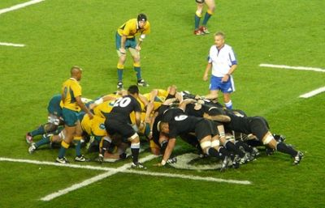
Agenda
Scrumdamentals
Context - Agile
Overview
Roles
Time Boxes
Artefacts
Rules
Scrum with VS2010
Hints
Best Practices
Templates

Slide 3
Agile on one slide
Waterfall
Comprehensive process
Formal complete specification
Full Design
BDUF
Coding
Testing
Stabilisation
Release
Agile
Lighter framework
Short iteration
Many techniques
XP
TDD
CI
Etc.

Slide 4
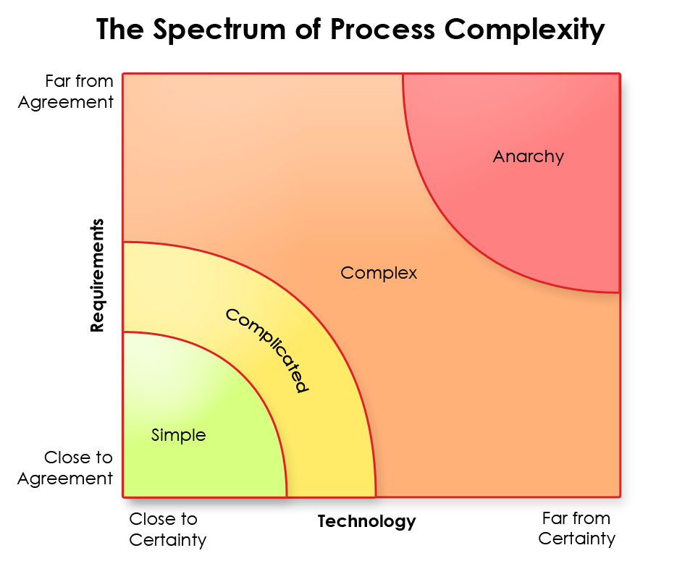
What kind of problem?
http://www.lostgarden.com/2006/04/managing-game-design-risk-part-i.html

Slide 5
The Agile Manifesto
Individuals and interactions over processes and tools
Working software over comprehensive documentation
Customer collaboration over contract negotiation
Responding to change over following a plan
http://agilemanifesto.org/

Slide 6
Scrum @ 60,000 feet
Scrum is the most popular of the agile development frameworks
Iterative and empirical approach to solve complex problems
Each sprint the focus is to build an increment of potentially shippable functionality
Can utilise other processes or techniques within the framework

Slide 7
Scrum @ 30,000 feet
Iterative, incremental approach to reduce risk and maintain focus on goals
Regular “inspect and adapt” reviews of the product, as well as the team
Transparency key to achieving success
Cross-functional, self managing teams (7 ± 2 members)

Slide 8
Scrum @ 10,000 feet
Roles | Timeboxes | Artefacts
Product Owner | Release Planning Meeting | Product Backlog
ScrumMaster | Sprint Planning Meeting | Sprint Backlog
The Team | The Sprint | Burndown Chart
 | Daily Scrum Meeting | Working Software
 | Sprint Review Meeting
 | Sprint Retrospective

Slide 9
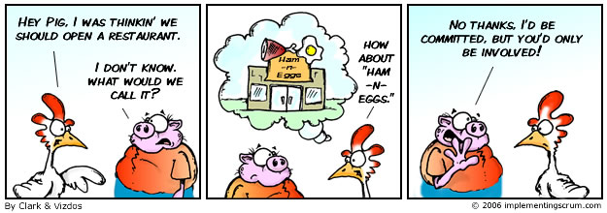
The pig and the chicken

Slide 10
The Pigs
The Scrum Team
Team
Scrum Master
Product Owner

Slide 11

The Chickens
Anyone else!
Other Scrum Teams
The Customer
The Sales Team
The Chief executive
The Cleaner

Slide 12

Product Owner
Voice of the customer
Defines the “What” of the product
Manages business value
Owns Product Backlog
Can change priorities of the product backlog – but not after it has been taken in to the sprint

Slide 13

Scrum Master
Manages the process
Shields team and removes impediments
Ensures team is cross-functional and focussed on improving quality
Facilitates close working between the Product Owner and The Team
Facilitator and a coach

Slide 14
The Team
Commit to create product backlog items into increments of potentially shippable functionality every sprint
Responsible for the “how”
Need to be cross-functional
No Titles, No Silos
Co-operative culture
Self Organising

Slide 15
Scrum Framework
24
Hours
Task
2 – 4
Weeks
Task
Task
Sprint
Backlog
Sprint
Product
Product
Backlog

Slide 16

Its all about timing!
No Peaks and troughs
8 hour burn
Sustainable pace
No “Death Marches”

Slide 17

Time Boxes
Release Planning Meeting
Sprint Planning Meeting
The Sprint
Daily Scrum Meeting
Sprint Review Meeting
Sprint Retrospective

Slide 18
Start up meetings
Release Planning Meeting
Overall plan on how to realise the vision
What is going to be in the first sprint(s)
Based upon the prioritised Product Backlog (list of items – PBI)
Sprint Planning Meeting
The team commits to achieving a Sprint Goal
Team creates the Sprint Backlog
Tasks needed to fulfil the selected PBI
Is the start of the sprint

Slide 19
DoD = Definition of Done
Agreed between Product Owner and the Team
Same across the enterprise
Start small and grow
Not done items not demonstrated at the review
Critical for the Team to keep this in sight

Slide 20
What is Done?
Fundamental
Mature
Code Analysis
Coded
Refactored
Code Reviewed
Unit Tested
Documented
Continuous Build
User Acceptance
Design Review
Design Refactored
Integration Tested
Regression Tested
Security Tested
Load/Soak Tested
Scalability Tested
Performance Tested

Slide 21

The Sprint (aka Iteration)
The time that the team builds an increment of potentially shippable functionality
As short as possible and no shorter (2-4 weeks)
Strict time box
Has a Daily Scrum Meeting
Start with Sprint Planning Meeting
End with Sprint Review Meeting and Sprint Retrospective Meeting

Slide 22
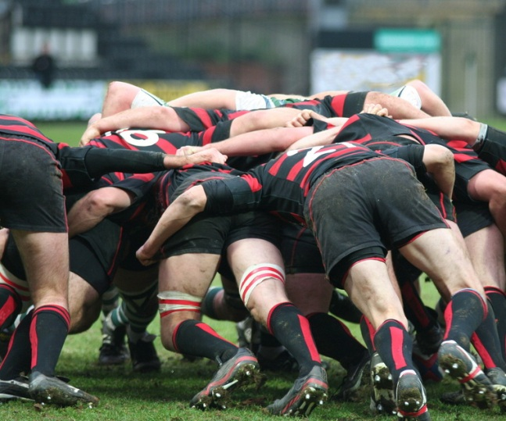
Daily Scrum Meeting
15 minute stand up
3 questions
What have you done since the last Scrum?
What will you do between now and the next Scrum?
What is in your way?
Not a status meeting
Not a problem solving meeting
Take it offline!

Slide 23
Development
The Team focuses on achieving the sprint goal
Self manages on how to achieve
Work delivered to the standard agreed in the definition of Done
Minimal interruptions
No change in sprint stories for the duration of the sprint

Slide 24
Sprint Review Meeting
Review Sprint Goal and Committed Product Backlog Items
The Team Presents the work “done”
Undone work is not shown
Informal
All Welcome (chickens, pigs, et al)
Time Boxed!
Hint – use a demo script

Slide 25
Sprint Retrospective Meeting
Team participates
No chickens
What was achieved?
What went well?
What could be improved on?
Review Metrics
Tasks for next sprint
Everyone should contribute

Slide 26
Artefacts
The Product Backlog
The Sprint Backlog
Burndown Charts

Slide 27
The Product Backlog
Owned by the Product Owner
Anyone can add to it
Regularly groomed by the Scrum Team
Each PBI has business value
High level estimates
Planning Poker
Size Only

Slide 28
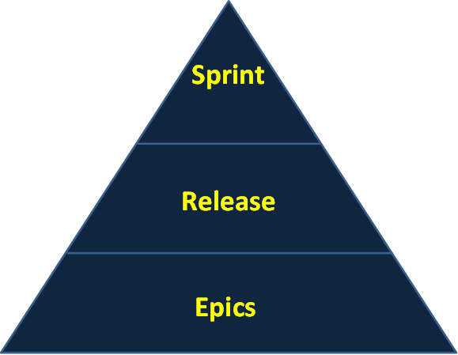
The PBI Iceberg
Detail
And
Understanding
Increase
towards
the top
The top
items have
The highest
Business
priority

Slide 29
Sprint Backlog
Tasks needed to complete Sprint Goal
Most created in Sprint Planning
Tasks emerge throughout Sprint
Task no more than 1 Day
Team estimate
Can use planning poker

Slide 30
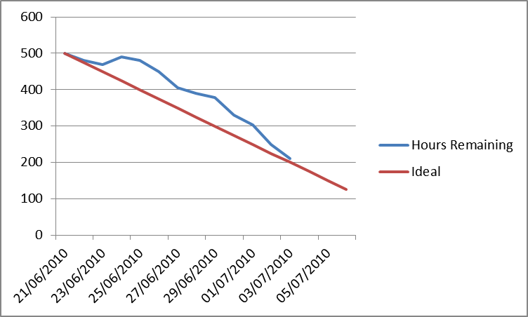
Burndown Chart
Work Remaining over Time

Slide 31
Traps And Dysfunctions
Start small
Don’t change Scrum
Highlights the issues
Issue existed before Scrum
No Product Owner
ScrumMaster is the Product Owner
Need Management Commitment for it to stick

Slide 32
Engineering Practices
Principles
Coupling, Cohesion, testability
Patterns
MS patterns & Practices, Gang of 4
Practices
TDD, Design by Contract, Defensive Programming
SOLID
Notes:
Initial
Stands for (acronym)
Concept
S
SRP
Single responsibility principle the notion that an object should have only a single responsibility.
O
OCP
Open/closed principle the notion that “software … should be open for extension, but closed for modification”.
L
LSP
Liskov substitution principle see also design by contract.
I
ISP
Interface segregation principle the notion that “many client specific interfaces are better than one general purpose interface.”^{[5]}
D
DIP
Dependency inversion principle the notion that one should “Depend upon Abstractions. Do not depend upon concretions.”^{[5]} Dependency injection is one method of following this principle.

Slide 33
How VS2010 Helps
Modelling (ultimate)
Test-First Development
Refactoring
Unit / System Testing
Continuous Integration
Code Analysis
Automated Testing
Coded UI Tests
Intellitrace
Wix 3.5 Support
Database Projects

Slide 34
Process Templates
Microsoft Scrum
http://visualstudiogallery.msdn.microsoft.com/en-us/59ac03e3-df99-4776-be39-1917cbfc5d8e
MSF Agile
Comes in the box!
Conchango V3
http://scrumforteamsystem.com/

Slide 35
Hints
Get a build server running
Use CI
What is the Branching Strategy
Set up XML Documentation
Use Code Analysis
Unit Test (at Least) early and often
Get the deployment sorted early
Use models to understand and refactor

Slide 36
Demo
Modelling Tools
Backlogs
Work Items

Slide 37

Professional Scrum Developer
New Program Just Launched in collaboration with
Microsoft
Scrum.org (founded by Ken Schwaber)
5 days training aimed at the development team and teaching how to develop a potentially shipable increment using
Scrum
Visual Studio 2010
Modern Engineering
Dates 13-17 September Microsoft TVP Reading

Slide 38
To book your place
http://courses.scrum.org/classes/show/66
http://www.accentient.com/scrum
Email: simon@accentient.com
Early booking and group discount available. Email for options.

Slide 39
Questions

Slide 40
Links
http://www.scrum.org
http://www.accentient.com/scrum
http://msdn.microsoft.com/en-us/vstudio/ff433643.aspx

Slide 41
Thank You
Contact:
Twitter s_reindl
Twitter Tag #proscrumdev
Email simon@accentient.com
Blog: http://blog.accentient.com/

